Slide 1


Slide 2
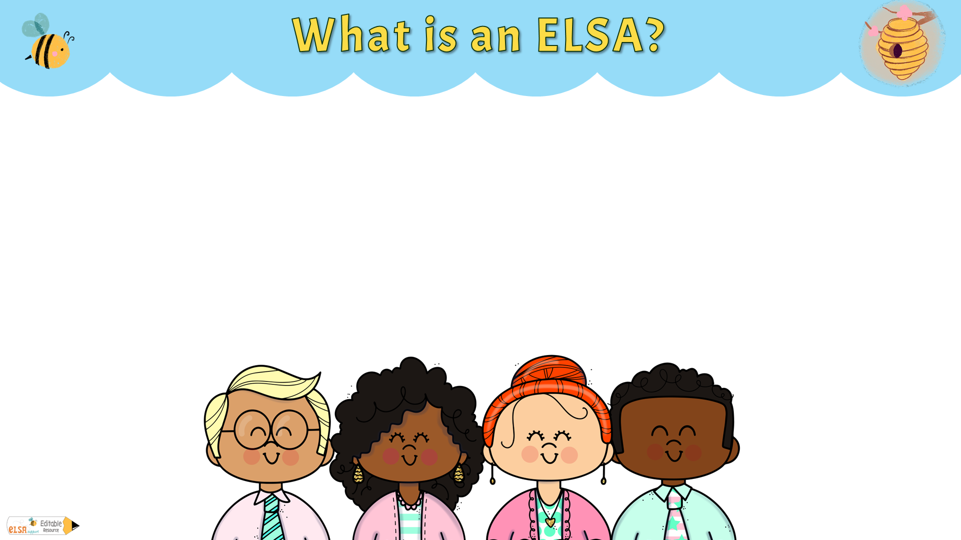
An ELSA is an Emotional Literacy Support Assistant.
An ELSA is a school-based support role, designed to support pupils with emotional and social needs.
ELSAs are usually experienced Teaching assistants who have had additional training by Educational Psychologists.
ELSAs work with individual pupils or small groups, using activities and strategies to help pupils build resilience, emotional literacy and coping mechanisms.

Slide 3

ELSAs attend supervision with the Educational Psychologists that trained them. This is a group supervision with peers and an Educational Psychologist.
Supervision provides a space for ELSAs to discuss the challenges they face in their work with pupils. This could include discussing specific cases, sharing experiences, and receiving advice on how to handle difficult situations.
Regular supervision ensures that ELSAs are using effective strategies and interventions. It also helps them stay updated with the latest research and best practices in emotional literacy and support.
Working with pupils who have emotional and social needs can be challenging and sometimes emotionally taxing. Supervision offers ELSAs a chance to reflect on their experiences and receive emotional support from their supervisor and peers.
Supervision sessions often include training elements where ELSAs can learn new techniques, tools, and approaches to better support the pupils they work with.
Supervision also plays a role in ensuring that the ELSA is working within safe and ethical boundaries, particularly when dealing with sensitive issues.

Slide 4
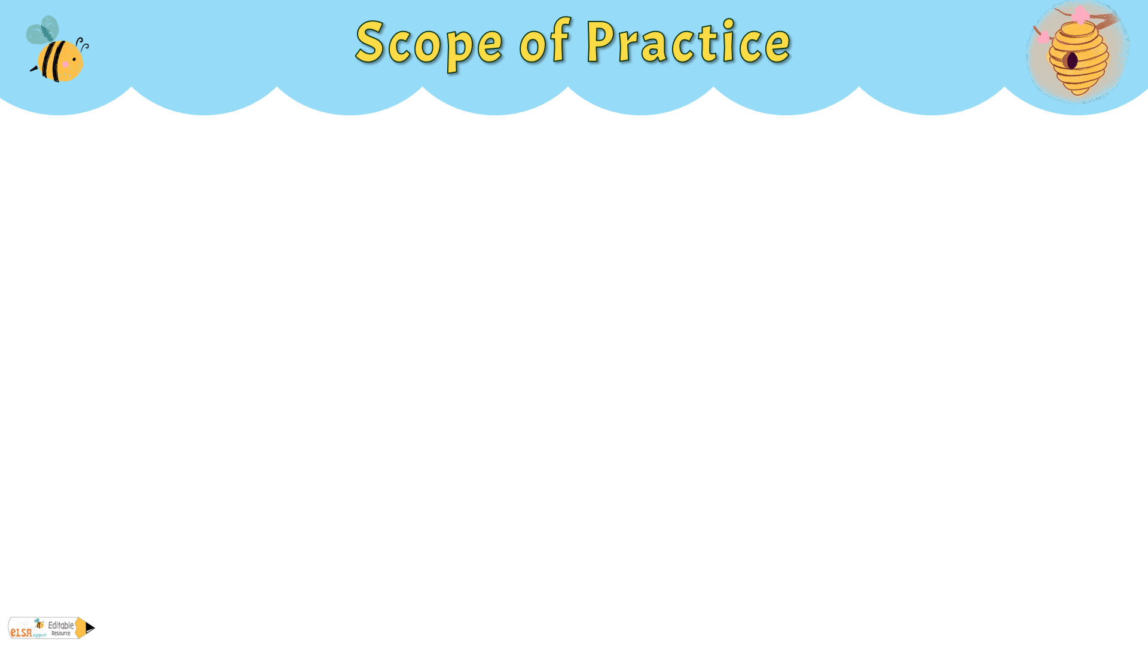
The scope of practice for an Emotional Literacy Support Assistant (ELSA) is defined by the specific training they receive and the intended purpose of their role within a school setting.
ELSAs are trained to support pupils with emotional and social needs, but their scope is limited to certain types of interventions and support activities.
ELSAs should work within the scope of practice to ensure the safety of the pupils they are working with.
ELSAs work closely with teachers, parents, and sometimes external agencies, but they do not replace these roles. Their work is a complementary part of a wider support system.
Whilst maintaining confidentiality is important, ELSAs must follow school policies regarding safeguarding and are required to report any concerns about a pupil’s welfare.
The support provided by ELSAs is often short-term and focused on specific goals. Long-term therapeutic needs are beyond their scope and should be referred to appropriate services.

Slide 5
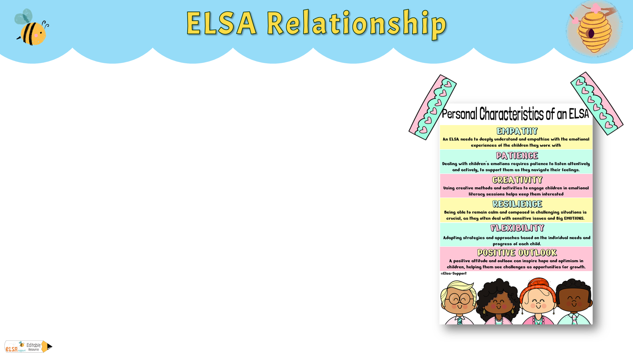
ELSAs are warm, kind and caring people who want to make pupils feel happy in school and to reach their potential socially, emotionally and academically .
ELSAs understand the barriers to learning that some pupils might have and can help support them with this.
ELSAs can support the pupil’s emotional development and help them cope with life’s challenges. They can help pupils find solutions to their problems.
Relationships are key in helping pupils and young people to feel safe and nurtured. ELSA is about creating a reflective space for the pupil.
A strong, trusting relationship between an ELSA and the pupil is essential for creating a safe and supportive environment where the pupil feels comfortable expressing their emotions.
ELSA Characteristics

Slide 6
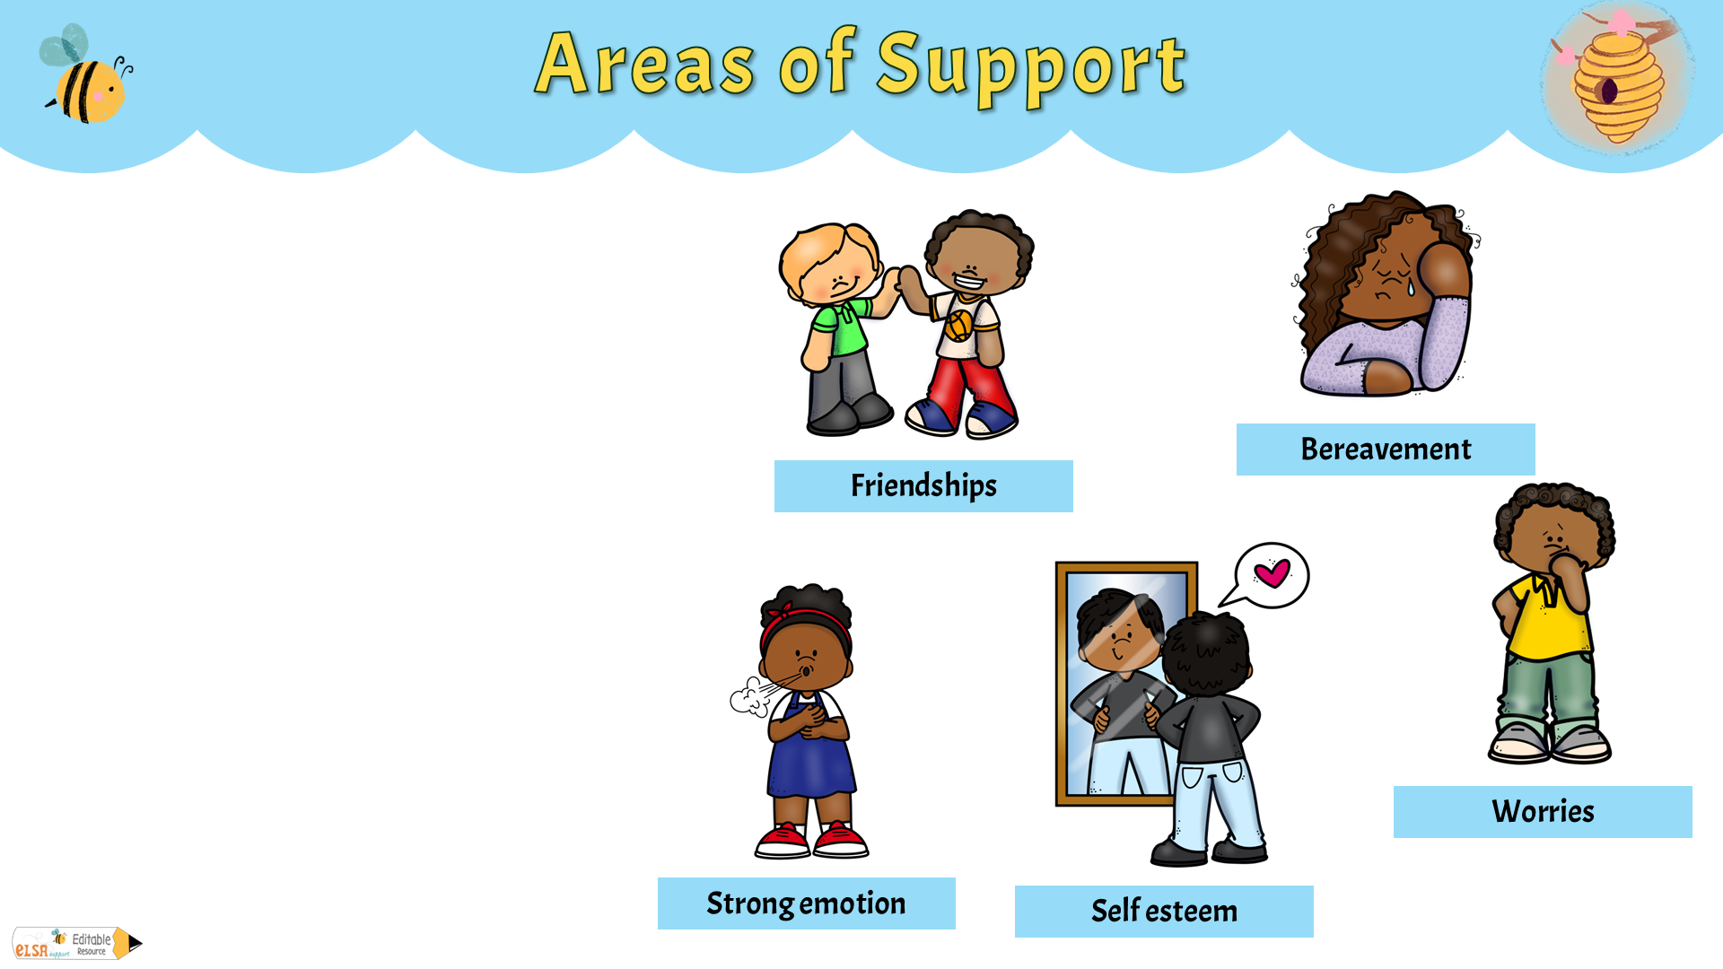
Loss and bereavement
Emotional Literacy
Self-esteem
Social Skills
Friendship issues
Relationships
Managing strong feelings
Anxiety and worries
Bullying
Conflict
Emotional Regulation
Growth Mindset
Social and therapeutic stories
Problem solving

Slide 7
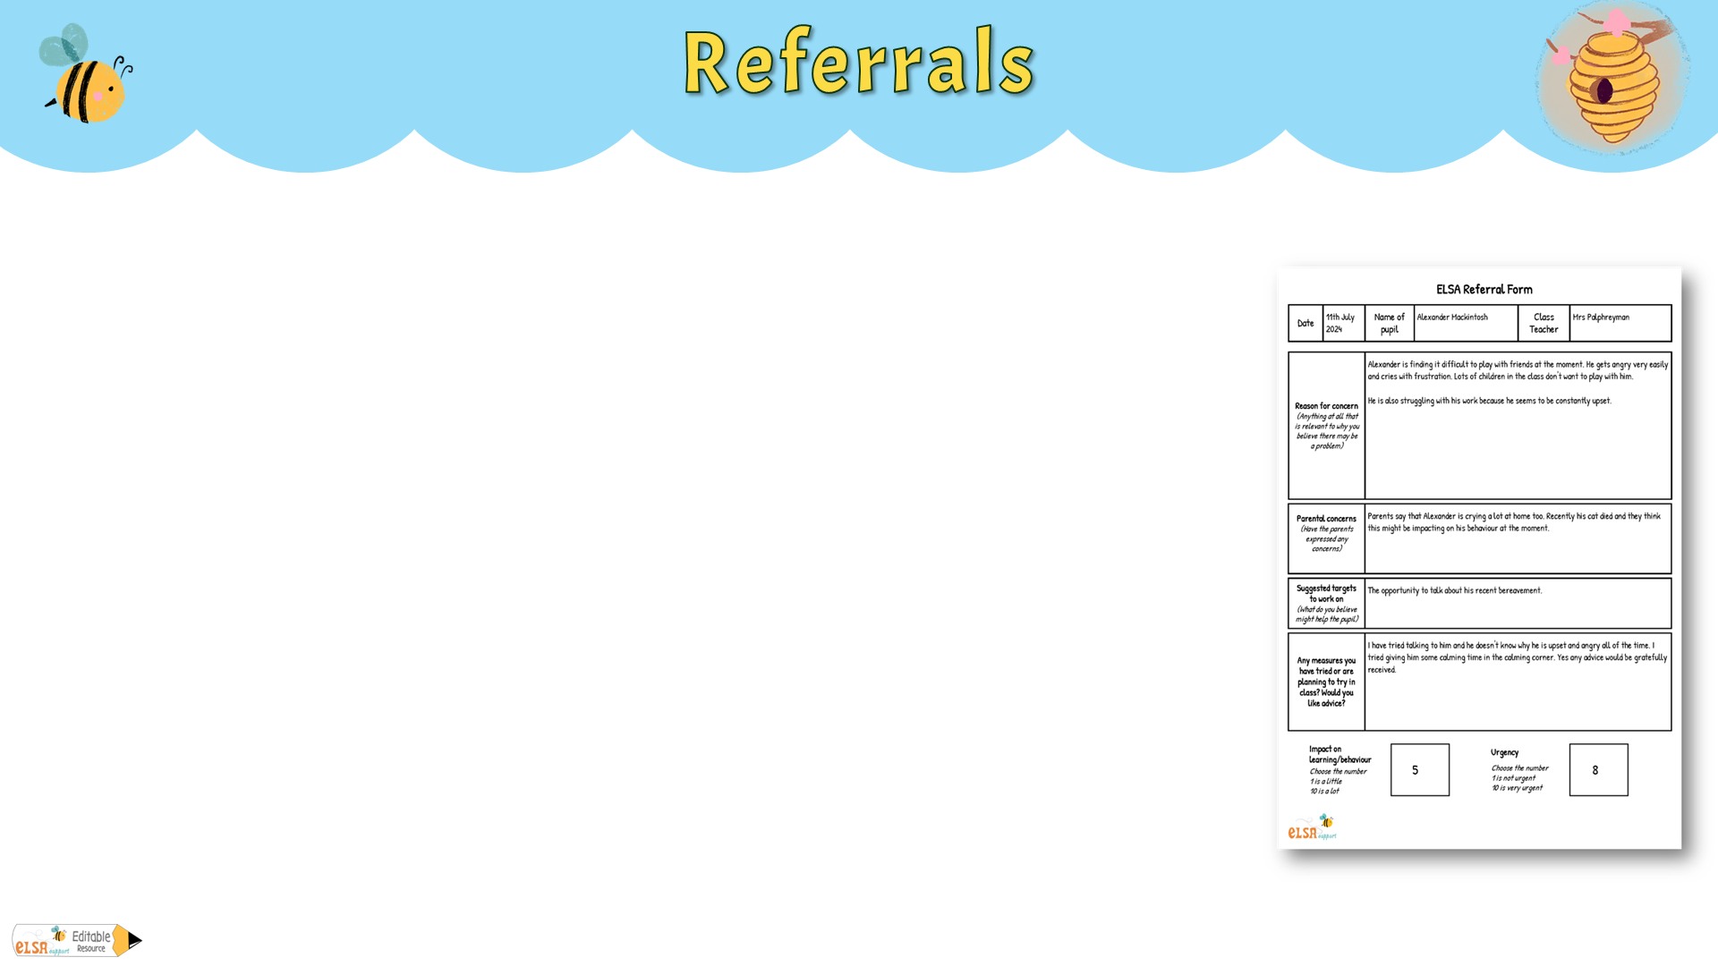
This is the process through which pupils are identified and recommended for support from an Emotional Literacy Support Assistant (ELSA). The referral process is crucial in ensuring that the right pupils receive the appropriate emotional and social support.
Identification of Need
Teachers may notice when a pupil is struggling with emotional or social issues, such as anxiety, low self-esteem, difficulties in making friends, or issues with big feelings. They may identify a pupil who could benefit from ELSA support based on their observations in the classroom.
Sometimes, parents might express concerns about their child’s emotional well-being or social interactions. They may request additional support through the school.
In some cases, older pupils may recognise they need help themselves.
Referrals may come from outside agencies.
Example referral form

Slide 8

Short-term focused support refers to targeted, time-limited interventions aimed at helping pupils with specific emotional or social challenges.
Specific, Targeted Goals:
The support focuses on addressing particular issues, such as managing anxiety, improving social skills, or boosting self-esteem.
Goals are clear and measurable, ensuring that the intervention remains focused and effective.
Time-Limited Intervention
Support is designed to be brief, usually spanning 6 to 12 sessions over half a term or full term.
This limited duration is set from the beginning, providing a structured approach to addressing the pupil’s needs.
Personalised Support
The ELSA tailors activities and strategies to the individual needs of the pupil either one to one or in a small group.
Regular monitoring and feedback
Progress is closely monitored throughout the intervention and also a pre and post assessment is done to measure impact overall.
Adjustments can be made, if necessary, based on how the pupil is responding to the support.
Evaluation
At the end of the support period, the ELSA reviews the pupil’s progress against the initial goals and their pre assessment.
If objectives have been met, the support is phased out and the pupil may be given strategies to continue their progress independently.
If further support is needed, the ELSA may extend the intervention slightly or refer the pupil to more specialised services.

Slide 9
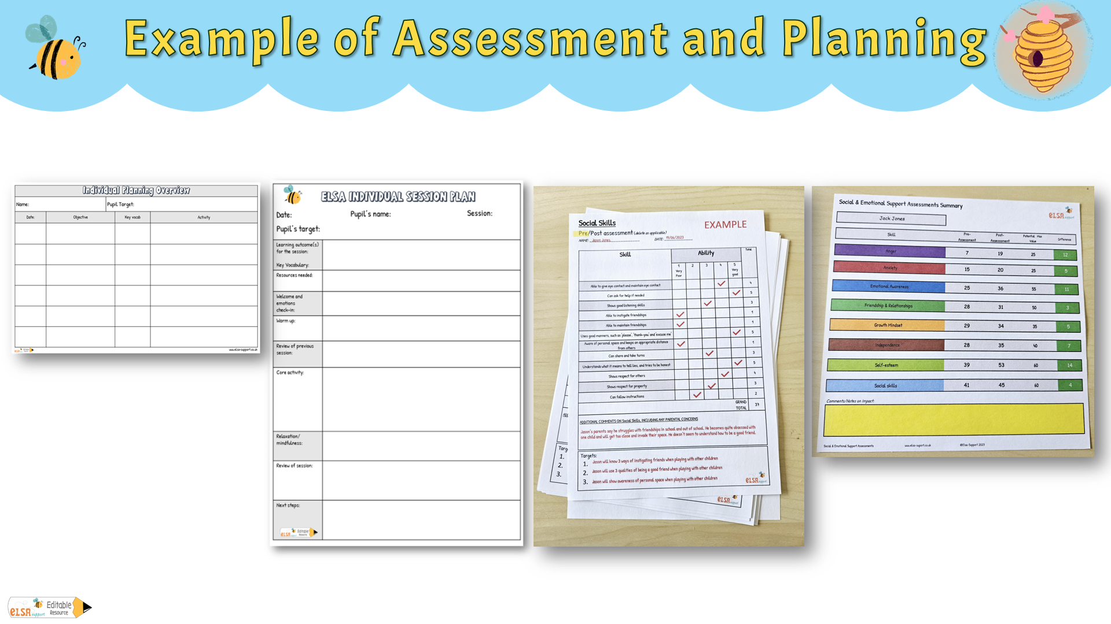
Here are examples of planning and assessment sheets that can be used for ELSA intervention.
Overview for six sessions
Excel assessments
Individual session plan
Assessments

Slide 10
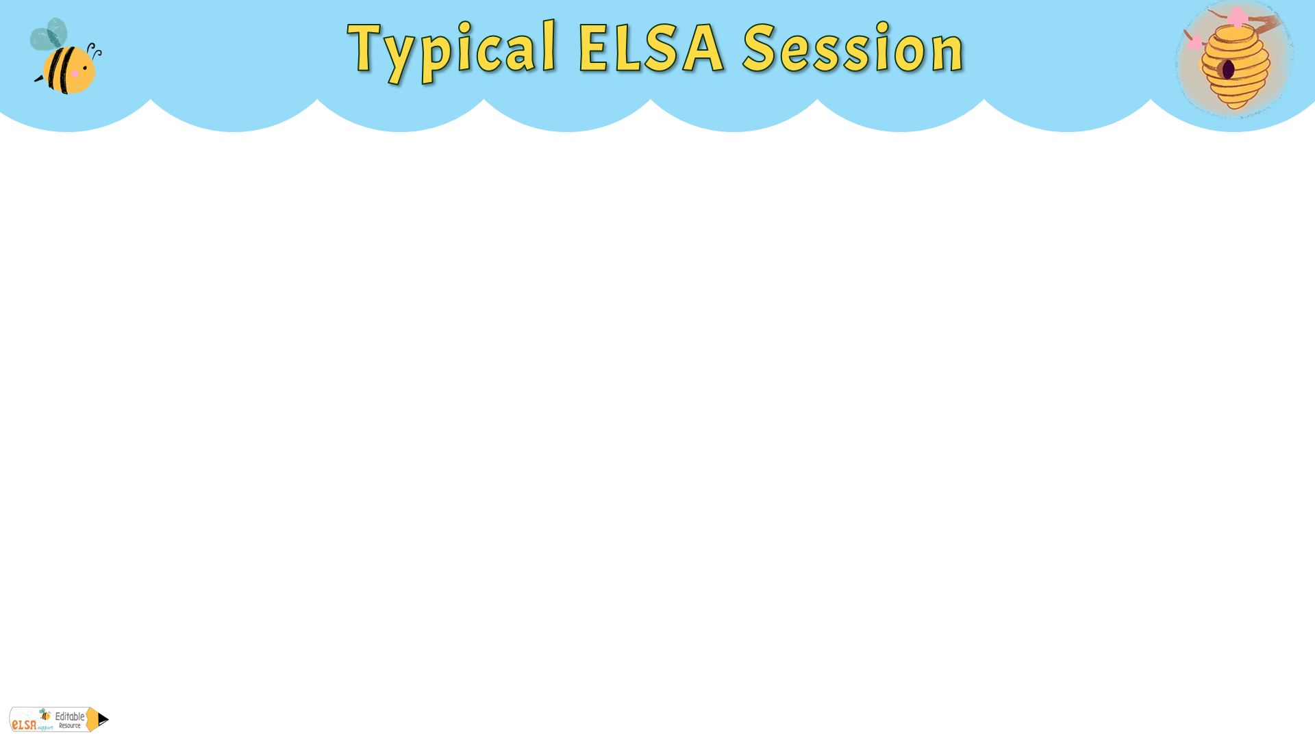
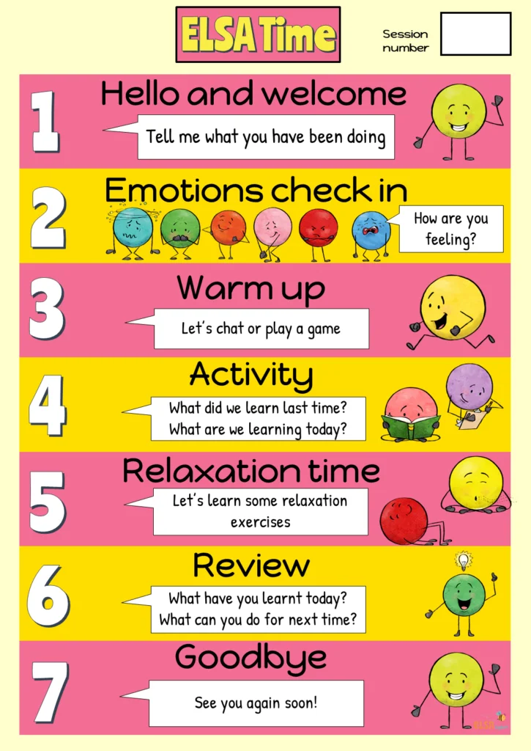
There would be a welcome for the pupil along with an emotional check in. How do they feel today?
A warmup or icebreaker game or activity would be played. This part is important because it helps the pupil to feel relaxed and feel safe.
The main activity would follow where the ELSA would be teaching something to help the pupil with their target. The ELSA would also review what was learnt last time to see if the pupil has remembered and if they used the skill taught.
There would be a relaxation exercise to help the pupil be ready for class and a quick review on what the pupil has learnt that session. At this point the ELSA may ask the pupil to do something for next time. eg. practise star breathing when feeling angry
Visual timetable of a session

Slide 11

There may be times when it is appropriate for an ELSA to respond immediately to a pupil’s needs. This would be reactive support.
A pupil who suddenly becomes upset or angry in class may need support from an ELSA. The ELSA may help with coping/calming skills.
Conflict with their peers, the ELSA may help the pupil reflect on what happened and develop strategies for resolving the conflict.
If a pupil receives distressing news e.g. a family member ill, or a pet has died. The ELSA can provide immediate support to help them cope with their big emotions.
If a pupil is upset after being bullied, an ELSA can help the pupil and come up with a plan to address the bullying.
Conflict at home. A pupil may witness conflict at home and come to school upset. An ELSA can use active listening to support the pupil.
A pupil who has fallen out with their best friend and is upset. The ELSA may help the pupil explore their feelings and develop strategies to mend the friendship.

Slide 12

ELSA communication with parents is important and here are some of the reasons why:
Ensures strategies used at school are reinforced at home, leading to more effective outcomes.
Parents provide insights into their child’s behaviour outside school, helping ELSAs tailor support more effectively.
Good communication allows early identification and proactive intervention of emerging issues.
Parents can reinforce emotional literacy skills at home, helping their child apply and internalise what they’ve learnt.
Builds trust between parents and the ELSA, fostering a collaborative approach to the pupil’s emotional development.
Enables tracking of the pupil’s progress and adjustment of strategies based on feedback from home.

Slide 13

Strength cards
Digital resources and Apps
Puppets
Affirmation cards
Emotion journals or diaries
Scenario cards
Playdough
Music
Worksheets and workbooks
Games
Sensory items
Sand play
Guided meditation
Emotion cards and charts
Calming jars or glitter bottles
Art and crafts
Lapbooks
Mindful colouring
Small world toys
Lego bricks
Books and stories
Role play

Slide 14

ELSAs provide a safe space for pupils to explore and understand their emotions, fostering overall well-being.
Every pupil is unique, and ELSAs tailor their approaches to meet individual needs, ensuring that each pupil receives the support they require.
Effective communication between ELSAs, parents, teachers, and other professionals is vital for ensuring a cohesive support system for each pupil.
ELSAs are able to both plan and respond, addressing issues before they escalate and providing immediate support if needed.
Recognising and celebrating even small victories can significantly boost a pupil’s confidence and motivation to continue their emotional growth journey.

